Slide 1

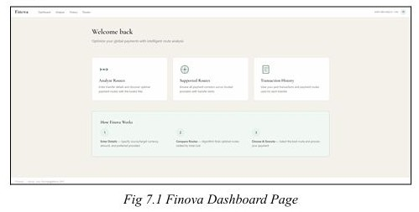
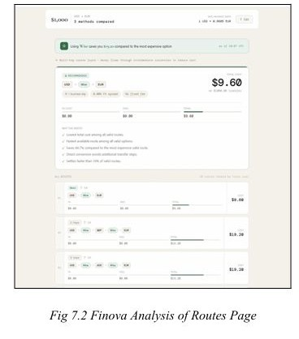
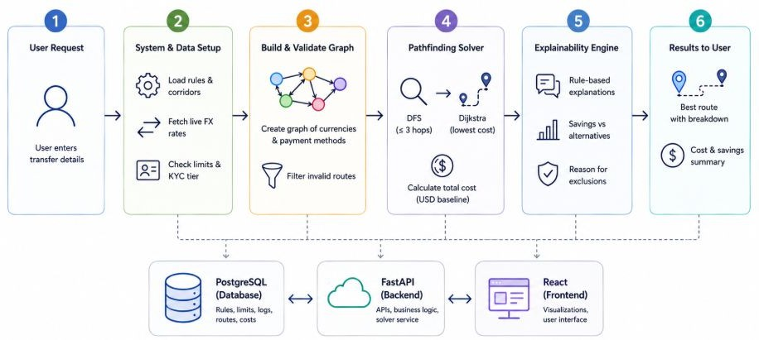
RV College of Engineering, Bengaluru – 560059.
Title: Algorithmic Financial Flow Arbitration Engine
Prarthana Upadhyaya | Rahul P 1RV24CS202 | 1RV24CS219
Go, change the world
CSE Dept.
Introduction
Tools and Techniques used
Finova is a multi-hop payment routing engine that identifies the cheapest cross-border transfer paths by modeling the global payment network as a directed weighted graph. Using
Tools:
Techniques:
FastAPI
PostgreSQL
NetworkX
ExchangeRate API
React
Tailwind CSS
Recharts
Axios
Graph Modeling
Dijkstra's Shortest-Path Algorithm
Depth-Limited DFS
In-Memory Constraint Validation
Rule-Based Explainability
Asynchronous State Management
depth-limited DFS and Dijkstra's algorithm, it discovers cost-effective routes through intermediate currencies while validating them against live exchange rates, provider limits, and user KYC tiers. The system delivers low-latency route optimization with transparent cost breakdowns and rule-based explanations for international payments.
Problem Definition
Algorithms Used
Current international payment systems rely on fixed provider networks and direct currency conversions, often resulting in
Dijkstra's Shortest Path Algorithm
Finds the minimum-cost path in a weighted graph. Identifies the cheapest payment route based on exchange rates and transaction fees. Time Complexity: O((V + E) log V) using a priority queue.
high FX spreads, intermediary fees, and inefficient cross-border transfers. This project addresses these limitations by using graph-based route optimization with live exchange rates and provider constraints to identify cheaper, transparent, and compliant payment routes.
Depth-Limited Depth-First Search (DFS)
Explores all possible paths up to a fixed depth. Discovers valid non-cyclic payment routes with a maximum of three currency hops. Time Complexity: O(V + E) for an adjacency list representation.
Objectives
1. Develop a high-performance payment routing engine capable
of discovering optimal international transfer paths using
graph-based algorithms.
2. Model global payment networks as directed weighted graphs and apply DFS with Dijkstra's algorithm to compute the lowest-cost transaction route.
Results and Discussions
3. Build a transparent explanation engine that validates
routing
constraints and generates human-readable decisions.
4. Develop a responsive dashboard with route visualization, cost analysis, and transaction history.
Methodology
Conclusions
This project demonstrates how graph algorithms and real-time financial data can be combined to optimize
international payment routing. By identifying the most cost-effective
multi-hop currency paths while ensuring
regulatory compliance and transparency, the system provides a smarter, faster, and more economical alternative to traditional cross-border payment methods.
Outcome of the work
Requirement Analysis: Identified system requirements for real-time payment route optimization.
System Design: Designed a graph-based architecture with FastAPI, PostgreSQL, and React.
Data Validation: Integrated live exchange rates and validated transaction constraints.
Pathfinding: Implemented DFS and Dijkstra's algorithm for cost-optimal routing.
Explainability: Generated transparent, rule-based route explanations.
Frontend: Developed a responsive interface for route visualization and cost analysis.
Optimizes international payments by identifying the lowest-cost multi-hop transfer routes.
Delivers fast, data-driven route recommendations using live exchange rates and graph-based optimization.
Provides clear cost breakdowns while ensuring routes satisfy provider constraints and KYC requirements.
References
Velmurugan, R., & Reeba, O. B. (2025). A Graph-Based Analysis of Digital Payments and Digital Technologies. In Graph Theory for Computer Science (pp. 475–488).
Mishra, S., Aggarwal, V., Pal, S., & Agarwal, V. (2025). HeRo: Heuristic-Based Routing in Payment Channel Networks. IEEE Networking Letters, 7(1), 56–60. DOI: 10.1109/LNET.2024.3520350.
Zhang, C. (2024). An Enhanced Benders Decomposition Method for Unique Shortest Path Routing. OPSEARCH, 61, 989–1012. DOI: 10.1007/s12597-023-00718-0.
Kantheti, P. R., & Bvuma, S. (2024). Real-Time Payment Systems for Boosting Economic Productivity. International Journal of Scientific Research in Science, Engineering and Technology, 11(4), 308–315. DOI: 10.32628/IJSRST24114169.

